Slide 1
Lambda Functions in LISP
>>(defun doubler (n) (lambda (x) (* x x)))
>>(doubler 5) -> returns a object of function
>>(funcall * 5) -> '*' contains the last result
Notes:
‹#›

Slide 2
int *x = (int *) malloc ((sizeof (int)))
*x = 10;
What will be the memory layout ?
Notes:
‹#›

Slide 3
Storage Management
Stack -> variables , activation records
Heap -> variables !!!
Notes:
‹#›

Slide 4
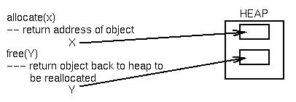
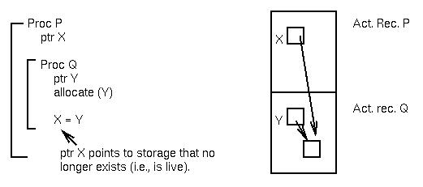
Heap storage
Dynamic allocation and stacks are generally incompatible.
Notes:
‹#›

Slide 5
Stack and heap location
Pointer X points to stack storage in procedure Q's activation record that no longer is live (exists) when procedure Q terminates. Such a reference is called a dangling reference.
Notes:
‹#›

Slide 6
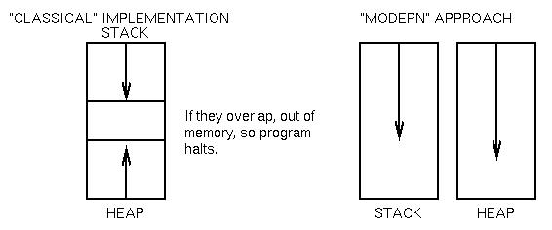
Stack and heap location
Dynamic storage is usually a separate structure in C, Ada, Pascal ...
Notes:
‹#›

Slide 7


Heap storage problems
Major storage for ML, LISP and Prolog is a heap.
Get storage - allocate(x)
free storage - free(x)
Problems:
Dangling reference:
allocate(x);y = x;
free(x);
⇒ y still points to allocated
Inaccessible storage:
allocate(x);
allocate(x);
⇒ first allocation to x now lost.
Memory fragmentation …(next slide)
Notes:
‹#›

Slide 8
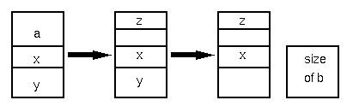
Memory fragmentation
Memory fragmentation:
allocate(a);
allocate(x);
allocate(y);
free(a);
allocate(z);
free(y);
allocate(b);
⇒ No contiguous space for b
Notes:
‹#›

Slide 9
How to solve this problem ?
Garbage Collection
Notes:
‹#›

Slide 10
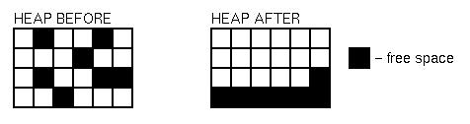
Garbage collection goal
Process to reclaim memory.(Solve Fragmentation problem.)
Algorithm: You can do garbage collection if you know where every pointer is in a program. If you move the allocated storage, simply change the pointer to it.
This is true in LISP, ML, Java, Prolog
Not true in C, C++, Pascal, Ada
Notes:
‹#›

Slide 11
Garbage collection: Mark-sweep algorithm
First assume fixed size blocks of size k. (Later blocks of size n*k.)
This is the LISP case.
Two simple algorithms follow. (This is only an introduction to this topic. Many other algorithms exist)
Algorithm 1: Fixed size blocks;
Two pass mark-sweep algorithm:
1. Keep a linked list (free list) of objects available to be allocated.
2. Allocate objects on demand.
3. Ignore free commands.
4. When out of space, perform garbage collection:
Pass 1. Mark every object still allocated.
Pass 2. Every unmarked objects added to free list of available blocks.
Notes:
‹#›

Slide 12
Heap storage errors
Error conditions:
Dangling reference - Cannot occur. Each valid reference will be marked during sweep pass 1.
Inaccessible storage - Will be reclaimed during sweep pass 2.
Fragmentation - Does not occur; fixed size objects.
Notes:
‹#›

Slide 13
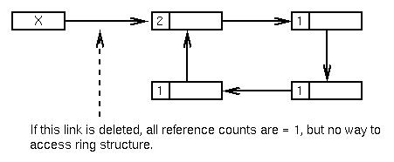
Garbage collection: reference counts
Algorithm 2:
1. Associate a reference counter field, initially 0, with every allocated object.
2. Each time a pointer is set to an object, up the reference counter by 1.
3. Each time a pointer no longer points to an object, decrease the reference counter by 1.
4. If reference counter ever is to 0, then free object.
Notes:
‹#›

Slide 14
Garbage collection: reference counts
Error conditions:
Dangling reference - Cannot occur. Reference count is 0 only when nothing points to it.
Fragmentation - Cannot occur. All objects are fixed size.
Inaccessible storage - Can still occur, but not easily.
Notes:
‹#›

Slide 15
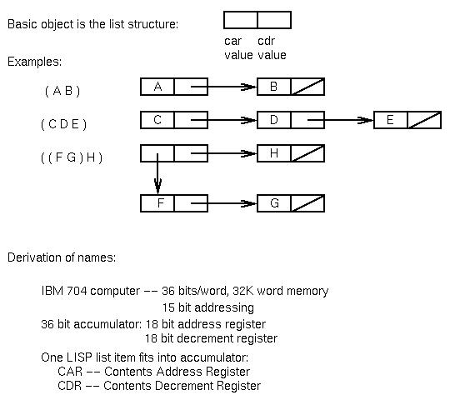
LISP data structures
Notes:
‹#›

Slide 16
Tracing Execution
(defun f1(x y z) (cons x (f2 y z ) ) )
(defun f2(v w) (cons v w) )
Notes:
‹#›

Slide 17
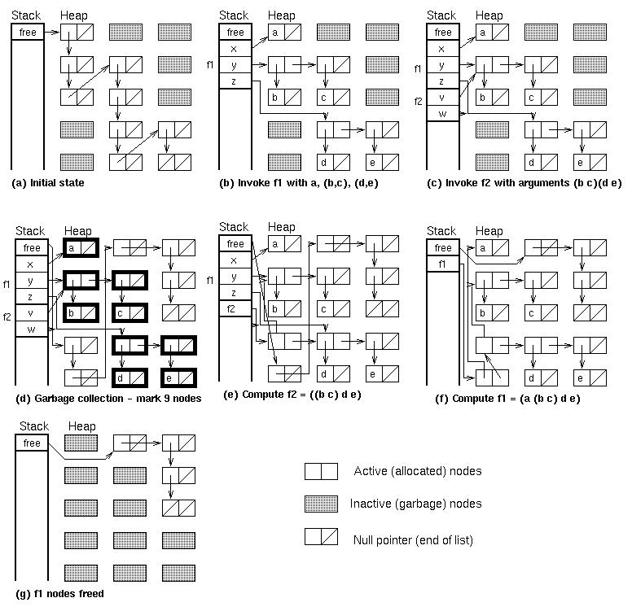
Notes:
‹#›

Slide 18
Memory compaction: Variable-size elements
With variable sized blocks, the previous two algorithms will not work.
In the left heap below, a block of size 3 cannot be allocated, even though 7 blocks are free.
If the allocated blocks are moved to the start of the heap (compaction) and the free blocks collected, then a block of size up to 7 can be allocated.
Notes:
‹#›

Slide 19
Compaction algorithm
For variable sized blocks, in pass 2 of the mark-sweep algorithm:
⇒ Move blocks to top of storage
⇒ Need to reset pointers that point to the old storage location to now point to the new storage.
How to do this?
Use tombstones and two storage areas, an A area and a B area:
1. Fill area A.
2. When A fills, do mark-sweep algorithm.
3. Move all allocated storage to start of B area. Leave marker in A area so other pointers pointing to this object can be modified.
4. After everything moved, area A can discarded. Allocate in B and later compact from B back to A.
Notes:
‹#›

Slide 20
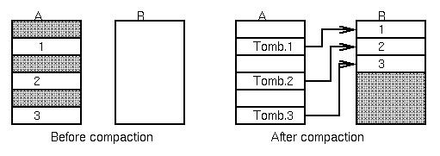
Compaction algorithm (continued)
Notes:
‹#›

